Slide 1
CU Boulder
Machine learning project 3

Slide 2
Outline:
The problem we need to solve and overview of the data
Use deep learning approach, why and how
Why Bert is a good choice
Code
Result
Github link: https://github.com/carsonxie/Machine-Learning-Projects/tree/main/c3%20--%20Deep%20Learning%20Method

Slide 3
What problem are we trying to solve?
Goal: To predict if a question from Quora is sincere or insincere.
(Quora Insincere Questions Classification | Kaggle)
sincere
Text sentence
A text Classifier
Insincere or toxic

Slide 4
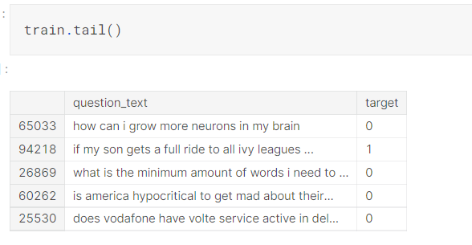
Overview of the data
Original train dataset: shape (1,306,122, 3)
Notes:
Pretty large dataset, aftering cleaning, only two columns, text and the label

Slide 5
Bert: why and how
Try to convince(at least myself) why bert is a very good choice.
Of course in this course, deep learning method is required
Published in 2018 by Google, quickly become a “baseline in NLP experiments” , use in search engine.
BERT learns contextual embeddings for words compare other embedding methods, by 2 ideas：
15% of tokens were masked and BERT was trained to predict them from context
and next sentence prediction
https://towardsdatascience.com/bert-explained-state-of-the-art-language-model-for-nlp-f8b21a9b6270
http://jalammar.github.io/illustrated-bert/

Slide 6
Code go through
https://nbviewer.org/github/carsonxie/Machine-Learning-Projects/blob/main/c3%20--%20Deep%20Learning%20Method/course3-final-project-nlp.ipynb

Slide 7
Result
Training time vs Model complexity
E.g. h256-A2 vs h768-A12, ~12min vs 1.5hr
Select right metric

Slide 8
Thank you for watching !

Slide 9
Reference and further reading:
https://www.youtube.com/watch?v=7kLi8u2dJz0&ab_channel=codebasics
https://www.youtube.com/watch?v=-9vVhYEXeyQ&ab_channel=Peltarion
Notebook link:

